Slide 1
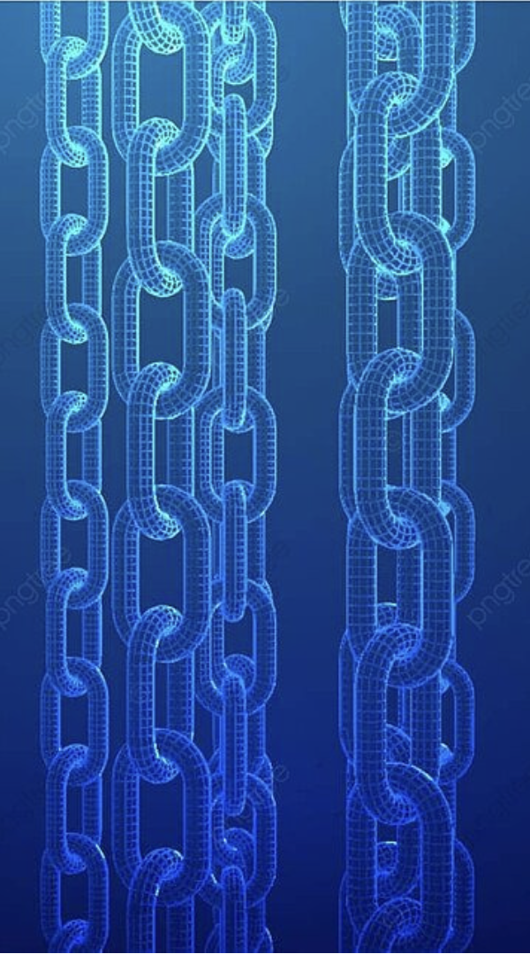
Blockchain from scratch
Joshua Musa
Nizar Soufiya
Ayooluwatomi Aiyeniko

Slide 2
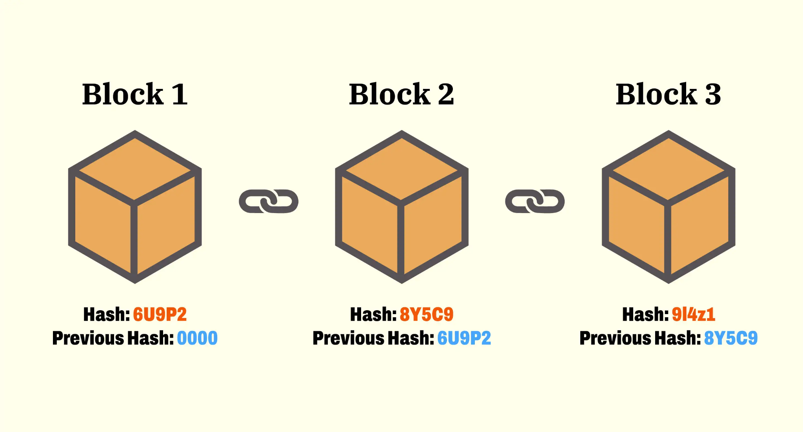
Blockchain
Composition of a block:
Data
Hash (fingerprint)
Previous Hash
Nonce

Slide 3



Theory
Simulating blockchain
Typescript
React display

Slide 4
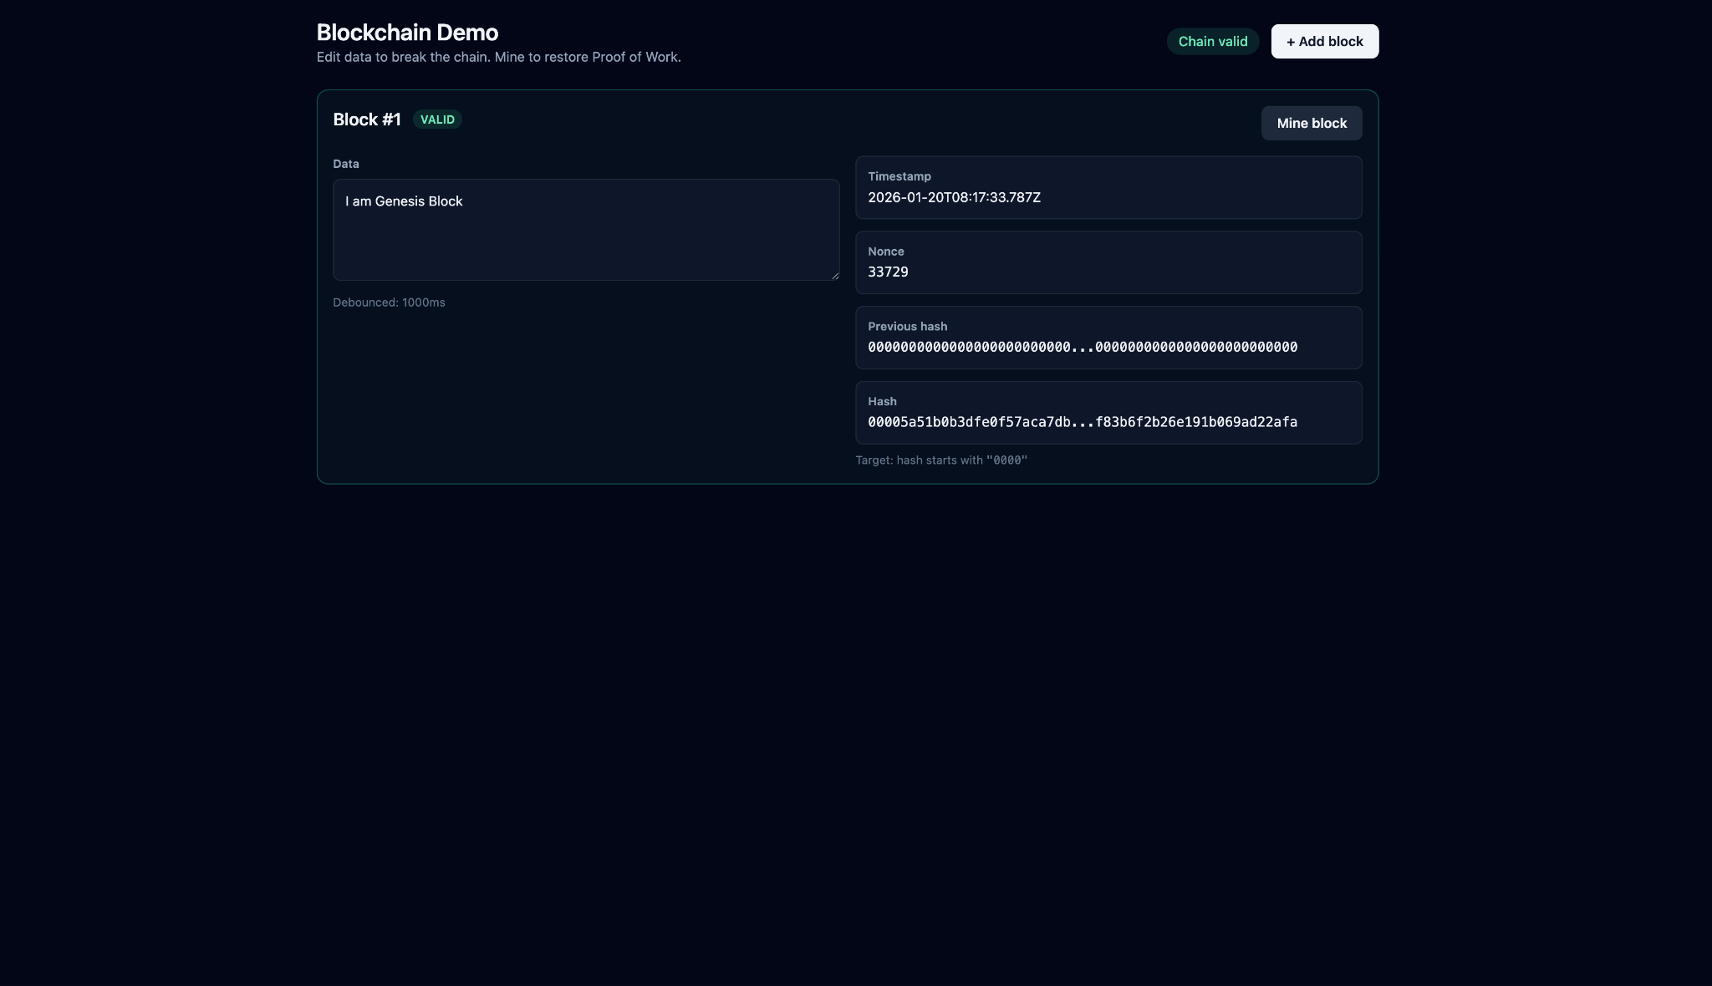

Slide 5
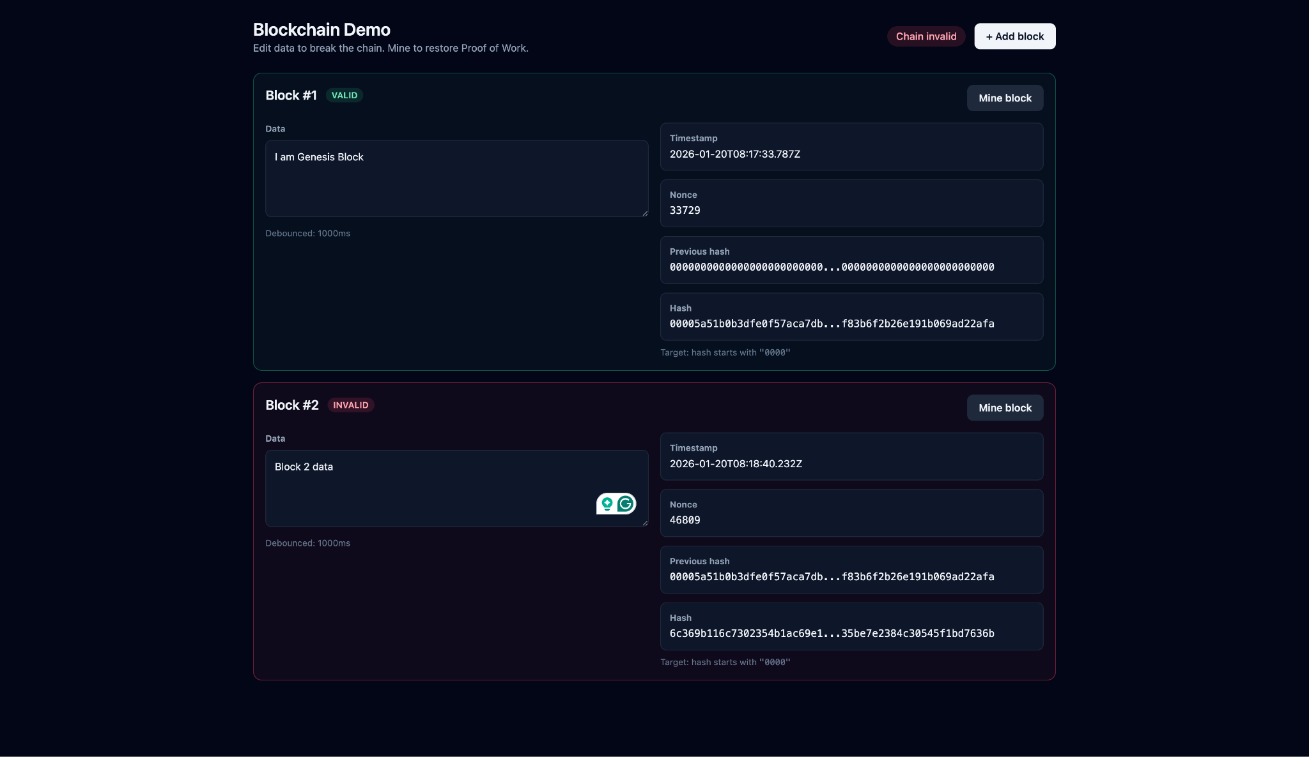

Slide 6
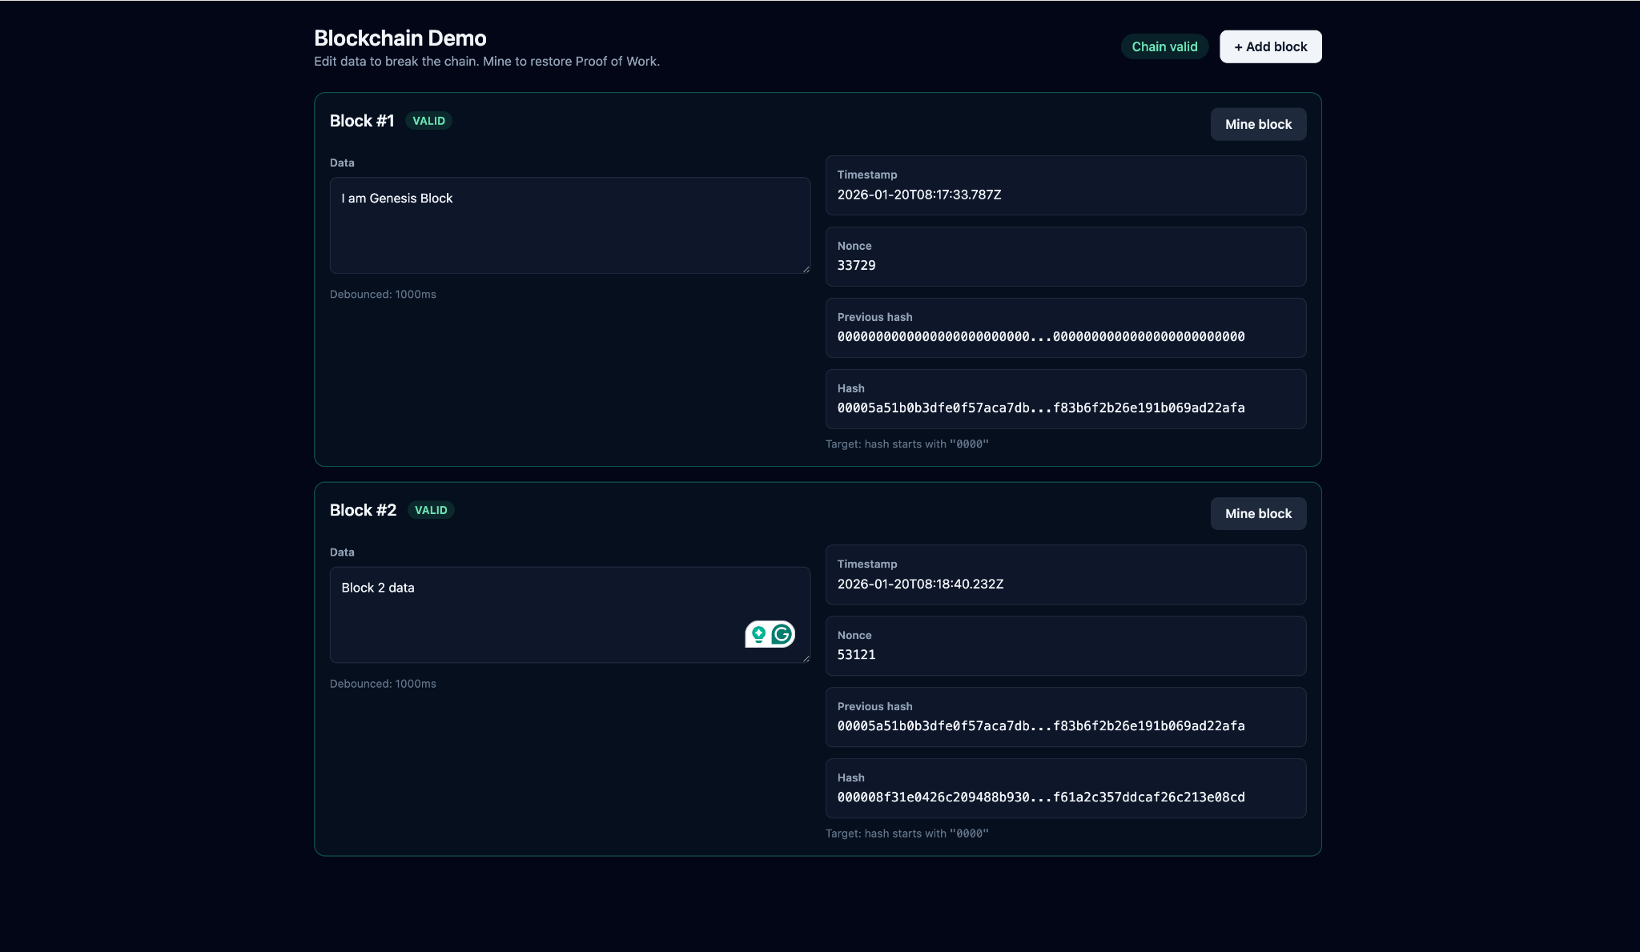

Slide 7
THANK YOU

